Slide 1


Department of Artificial Intelligence and Data Science
The Great Escape: Stopping Student
Disappearances in their Tracks
Dr.J.Manoranjini
Associate Professor
Nikilesh 221801035
Santhosh 221801047

Slide 2
Problem Statement and Motivation
Student dropouts are a growing concern for educational institutions, leading to long-term negative impacts such as limited career prospects and lower earnings. Early identification of at-risk students is crucial for timely intervention, but predicting dropout risk is challenging due to the complex mix of academic, engagement, and socio-demographic factors.
Predicting and preventing student dropouts can improve lives and benefit society by reducing unemployment and crime rates. Early identification of at-risk students allows schools to provide targeted support, enhancing academic success and graduation rates. A predictive model also enables more efficient use of limited resources and fosters data-driven decision-making in educational institutions.

Slide 3
Objectives
The goal of this project is to develop an accurate predictive model to identify students at risk of dropping out, enabling early intervention to improve retention and graduation rates. By facilitating timely support for these at-risk students, the model will help educational institutions optimize the use of their resources, focusing on students who need the most assistance. Additionally, this tool will support data-driven decision-making by providing an interpretable and scalable solution, allowing schools to make informed choices to enhance student success.

Slide 4
Abstract
This project aims to develop a predictive model to identify students at risk of dropping out using logistic regression and random forest algorithms. Logistic regression, a statistical method, will be used for its interpretability and effectiveness in binary classification problems. Random forest, an ensemble learning technique, will be employed for its ability to handle large datasets with higher accuracy and its robustness to overfitting. By analyzing academic performance, engagement metrics, and socio-demographic factors, the model will provide early warnings to enable timely interventions and support, ultimately reducing dropout rates.

Slide 5
Introduction and Overview of the Project.
This project aims to address the challenge of student dropouts by developing a predictive analytics platform that identifies at-risk students using machine learning. By analyzing academic performance, engagement, and socio-demographic data, the system generates risk scores that enable early intervention and targeted support. The platform not only enhances the accuracy of dropout predictions but also equips educational institutions with the tools needed to make data-driven decisions, ultimately improving student retention and academic success.

Slide 6
Literature Survey
S.No | Author Name | Paper Title | Description | Journal | Volume/ Year
1. | Kotsiantis. S. | Predicting Student Dropout Using Machine Learning | Examines ML algorithms for dropout prediction | Applied Artificial Intelligence | 22/2020
2. | Varma, M. | Predicting Student Dropouts with Machine Learning: An Empirical Study in Finnish Higher Education | Analyze ML techniques for droupout prediction including datasource | Elsevier Ltd. | 09/2024
3. | Dekker. G. W. | Predicting Student Dropout: A Case Study | Uses decision trees for dropout analysis | Educational Data Mining Conference | 17/2014

Slide 7
Literature Survey
S.No | Author Name | Paper Title | Description | Journal | Volume/ Year
4. | Thammasiri. D. | Comparison of Techniques for Predicting Dropouts | Compares various ML techniques for dropout prediction | Journal of Educational Data Mining | 6/2016
5. | Costa. E. , Albergaria. H. | Educational Data Mining: Predicting Dropout | Uses data mining for dropout prediction | Computers in Human Behavior | 72/2017
6. | Aguiar. E. , Ambrose. G. | Early Prediction of Student Dropout | ML for predicting dropouts based on academic data. | Journal of Learning Analytics | 5/2018

Slide 8
Existing Sytem
Early Warning Systems (EWS): These systems use predictive models to identify students at risk of dropping out early in their academic journey. They often incorporate academic performance metrics, attendance data, and demographic information.
Learning Management System (LMS) Analytics: Analyzing student interactions within LMS platforms can provide insights into engagement levels, learning patterns, and potential dropout indicators.
Student Information Systems (SIS): These systems store comprehensive student records, including academic history, financial aid information, and disciplinary actions, which can be used for predictive modeling.

Slide 9
Drawback of Existing System
Limited Accuracy: Basic methods and simple statistical approaches often lack precision, failing to capture complex patterns and interactions in student data.
Data Integration Issues: Existing systems frequently struggle to integrate data from diverse sources, leading to incomplete or fragmented insights.
Scalability Challenges: Simple systems may not scale effectively with increasing amounts of data, leading to inefficiencies and potential inaccuracies as data volumes grow.
Limited Predictive Power: Basic models often lack the sophistication to identify subtle patterns or predict dropout risks with high accuracy, leading to potential oversights in identifying at-risk students.

Slide 10
Proposed System
Model Development:Logistic Regression for interpretability and Random Forest for accuracy and robustness will be used to predict student dropouts.
Model Evaluation: Models will be assessed based on accuracy, precision, and recall to determine which performs best.
Model Deployment:The chosen model will be deployed through a user-friendly interface or API, integrating with educational systems for real-time predictions and alerts.
Alert System:An alert system will notify educators about at-risk students, facilitating timely interventions and support.

Slide 11
System Architecture
.
Data sources
ETL Pocess
Model Evaluation
Extract
Trigger And Notifications
Acadameic performence
Transform
Prediction
Load
Visualization
Socio-Demographic
Random Forest
Logistic Regression
Engagement metrics
Hyperparmeter tuning
Model Training

Slide 12
Methodology
Dataset Collection: Collect data on academic performance, socio-demographic factors, and engagement metrics.
Loading Dataset: Use Pandas to load the dataset and check for missing values.
Missing Data Handling: Impute missing values using the mean for numeric columns and mode for categorical variables.
Encoding: Convert categorical data into numerical form using Label Encoding.
Normalization: Standardize numerical features using StandardScaler.
Train/Test Split: Split the data into 80% training and 20% testing sets.
SMOTE: Apply SMOTE to balance class distribution.
Logistic Regression: Train the model to predict dropout risk using binary classification.
Random Forest: Train an ensemble model to handle non-linear relationships and improve prediction accuracy.
Prediction Output: Generate probabilities for each model and calculate the mean probability for the final prediction.
Evaluation: Assess model performance using classification metrics like accuracy, precision, and recall.
Visualization: Display predicted probabilities and dropout risk categories (At Risk/Not At Risk).

Slide 13
List of modules
Data Handling Module
Data Processing Module
Model Training and Prediction Module
Reporting and Visualization Module

Slide 14
Data Handling Module
The Data Handling Module is responsible for loading and preparing the dataset for analysis. It starts by importing the dataset from a specified CSV file. The features are defined based on relevant attributes, and the target variable is set to indicate student dropout status. The target variable is converted into a binary format, with 'Dropout' represented as 1 and 'Non-Dropout' as 0. This conversion is accomplished using the formula:
𝑦=np.where(target==′droupout′,1,0)y=np.where(target== ′ Dropout ′ ,1,0)

Slide 15
Data Handling Module Feature Selection
Feature Selection Process:
Defining Features: Specific features relevant to predicting student dropout are selected based on domain knowledge and relevance. Examples include:
- Age at enrollment
- Previous qualification (grade)
- Admission grade
- GPA
- Attendance percentage
- Sociology-demographic factors (e.g., Gender, Course)

Slide 16
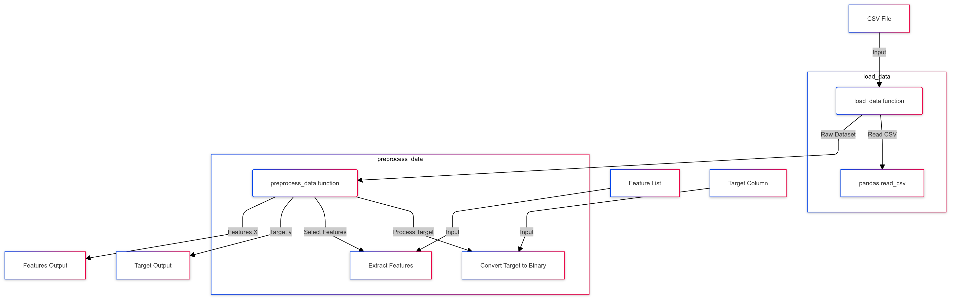
Data Handling Module DFD

Slide 17
Algorithm for Data Handling Module
Step 1: Load the dataset from a specified source (e.g., CSV file).
Step 2: Define relevant features and target variables based on domain knowledge.
Step 3: Convert the target variable into binary format (1 for Dropout, 0 for Non-Dropout).
Step 4: Handle missing values by imputing numeric features with the mean and categorical features with the mode.
Step 5: Save the cleaned and structured dataset for further processing.

Slide 18
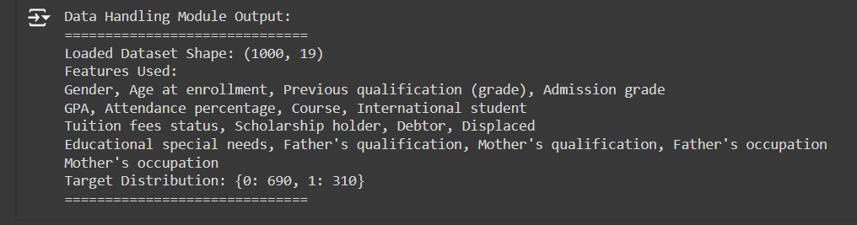
Data Handling Module Output

Slide 19
Data Processing Module
In the Data Processing Module, the dataset is preprocessed to make it suitable for model training. The dataset is split into training (80%) and testing (20%) sets using the train-test split method. This is expressed mathematically as:
X_train, X_test, y_train, y_test = train_test_split(X, y, test_size=0.2, random_state=42, stratify=y)
Additionally, the module scales numeric features using StandardScaler and applies one-hot encoding to categorical features to convert them into a format suitable for machine learning algorithms.

Slide 20
Data Processing Module Feature Selection
Feature Selection Techniques:
1. Train-Test Split:
X_train, X_test, y_train, y_test = train_test_split(X, y, test_size=0.2, random_state=42, stratify=y)
2. Handling Missing Values:
For numerical features: X_filled = X_original.fillna(mean)
For categorical features: X_filled = X_original.fillna(mode)
3. Encoding Categorical Features:
X_encoded = OneHotEncoder(X_categorical)
4. Feature Scaling:
X_scaled = (X - μ) / σ

Slide 21
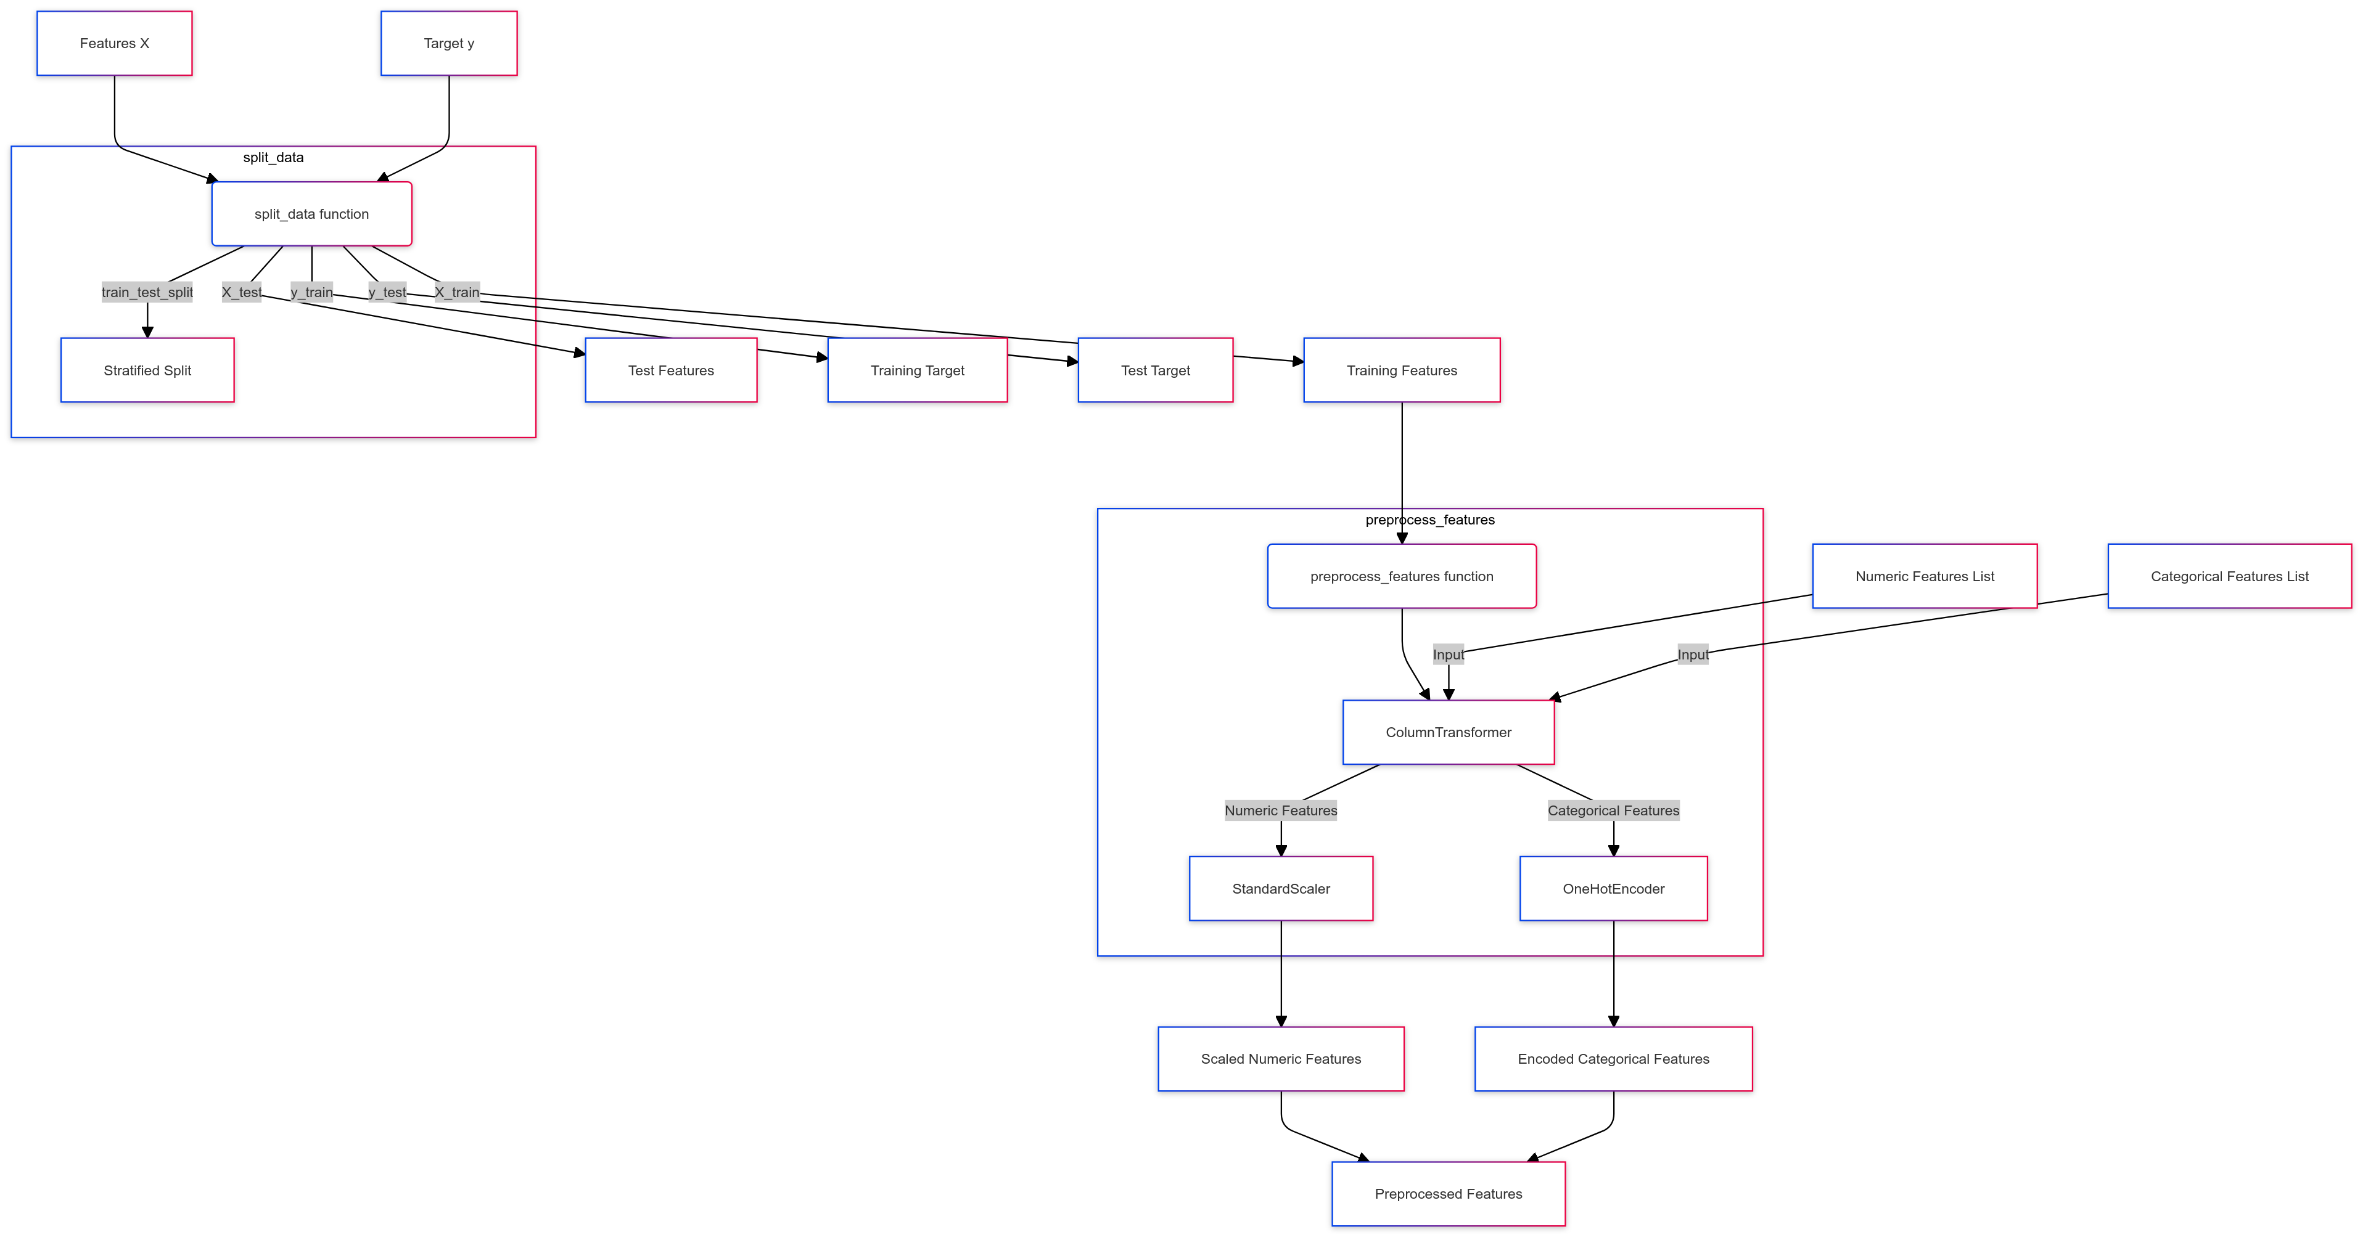
Data Preprocessing Module DFD

Slide 22
Algorithm for Data processing Module
Step 1: Split the dataset into training (80%) and testing (20%) subsets using stratified sampling.
Step 2: Normalize numeric features using StandardScaler to ensure uniform scaling.
Step 3: Encode categorical features into numerical values using one-hot encoding.
Step 4: Apply SMOTE to balance class distribution in the training set.
Step 5: Prepare the dataset for model training by verifying feature quality and data integrity.

Slide 23

Data Processing Module Output

Slide 24
Model Training and Prediction Module
The Model Training and Prediction Module trains the predictive models and generates predictions. It utilizes Logistic Regression and Random Forest classifiers on the training data to make predictions on the test set. The predicted probabilities for both models are computed, with the logistic regression model mathematically represented as:

Slide 25
Logistic Regression Feature Selection
1. Feature Selection:
Logistic Regression inherently evaluates all features but weightages are assigned based on their contribution to the prediction.
2. Coefficients Calculation:
•The model learns coefficients (β) for each feature through maximum likelihood estimation (MLE), optimizing the following likelihood function:
Log-Likelihood = ∑ (y_i * log(P(y_i)) + (1 - y_i) * log(1 - P(y_i)))
3. Sigmoid Function:
ŷ = σ(z) = 1 / (1 + e^(-z))
z = β_0 + β_1 * X_1 + β_2 * X_2 + ... + β_n * X_n

Slide 26
Random Forest Feature Selection
1. Feature Importance Calculation:
•a. Mean Decrease Impurity:
•Importance(X_j) = ∑ (Gini_before - Gini_after)
•b. Mean Decrease Accuracy:
•Accuracy_drop = Accuracy_original - Accuracy_permuted
2. Majority Voting:
•ŷ_RF = majority vote(T_1, T_2, ..., T_n)

Slide 27
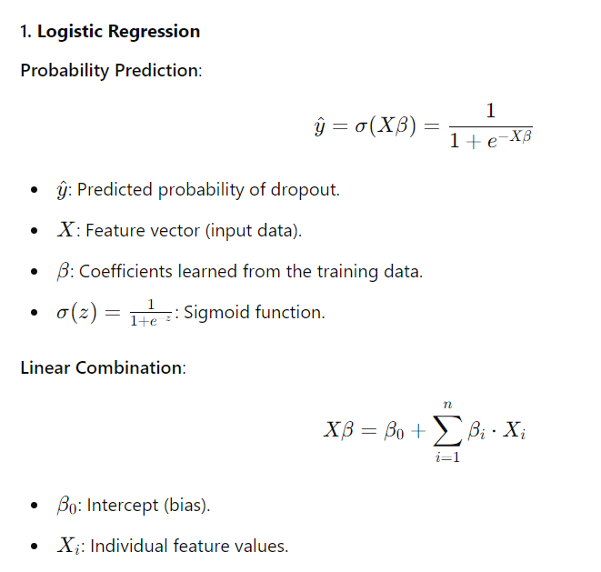
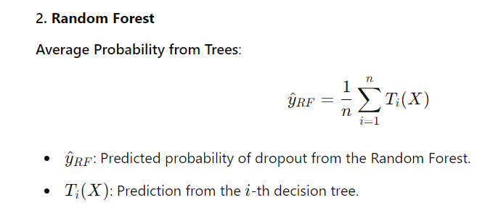
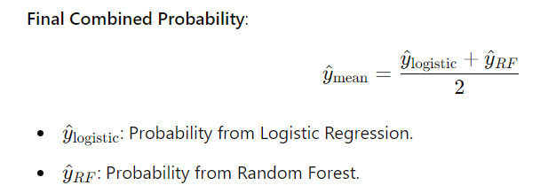
Formulation

Slide 28
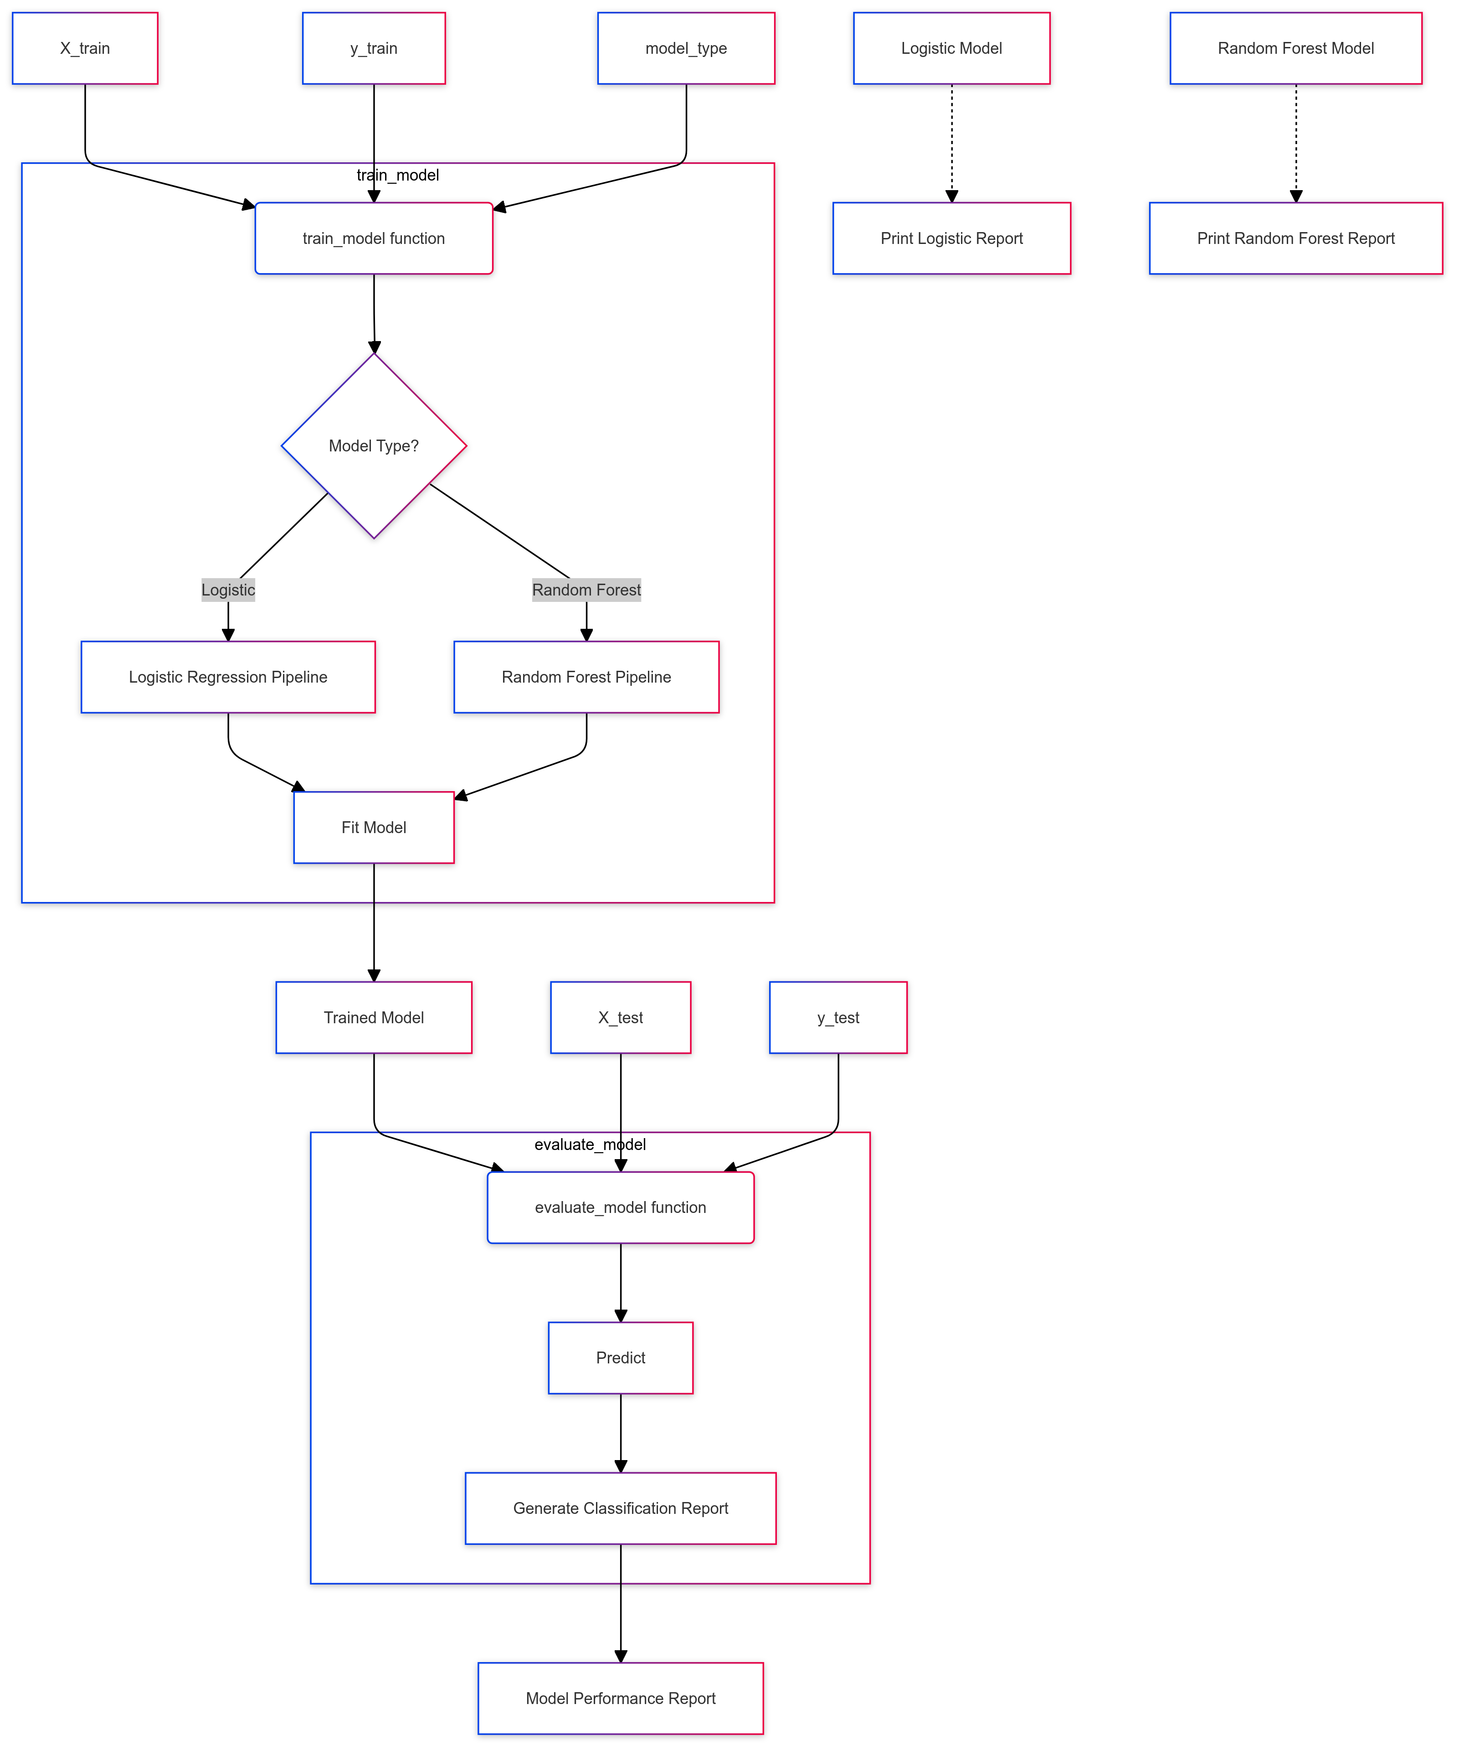
Model Training and Prediction Module DFD

Slide 29
Algorithm for Model Training and Prediction Module
Step 1: Train the Logistic Regression model using the training dataset.
Step 2: Train the Random Forest model to complement Logistic Regression with higher accuracy.
Step 3: Tune hyperparameters for both models to optimize performance.
Step 4: Generate predictions for the test dataset using both models.
Step 5: Combine the prediction probabilities from both models for a final dropout risk score.

Slide 30
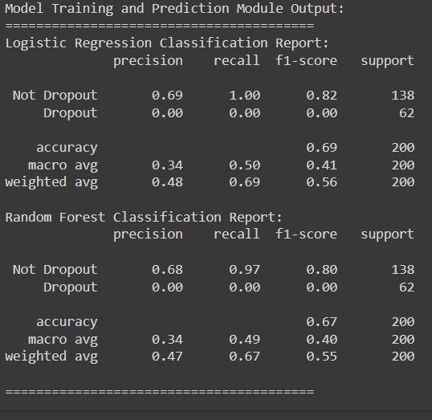
Model Training and Prediction Module Output

Slide 31
Reporting and Visualization Module
The Reporting and Visualization Module visualizes the model predictions and summarizes the findings. It filters the students identified as high-risk for dropping out based on a specified probability threshold (e.g., 0.3). The module generates bar plots to illustrate the top high-risk students, providing a clear visual representation of dropout probabilities. A summary table of predictions and associated probabilities is also displayed, with the mean probability calculated as:
Mean Probability = (Logistic Probabilities + RF Probabilities) / 2
This module aims to present the results in an understandable format for stakeholders, enabling informed decision-making regarding student retention strategies.

Slide 32
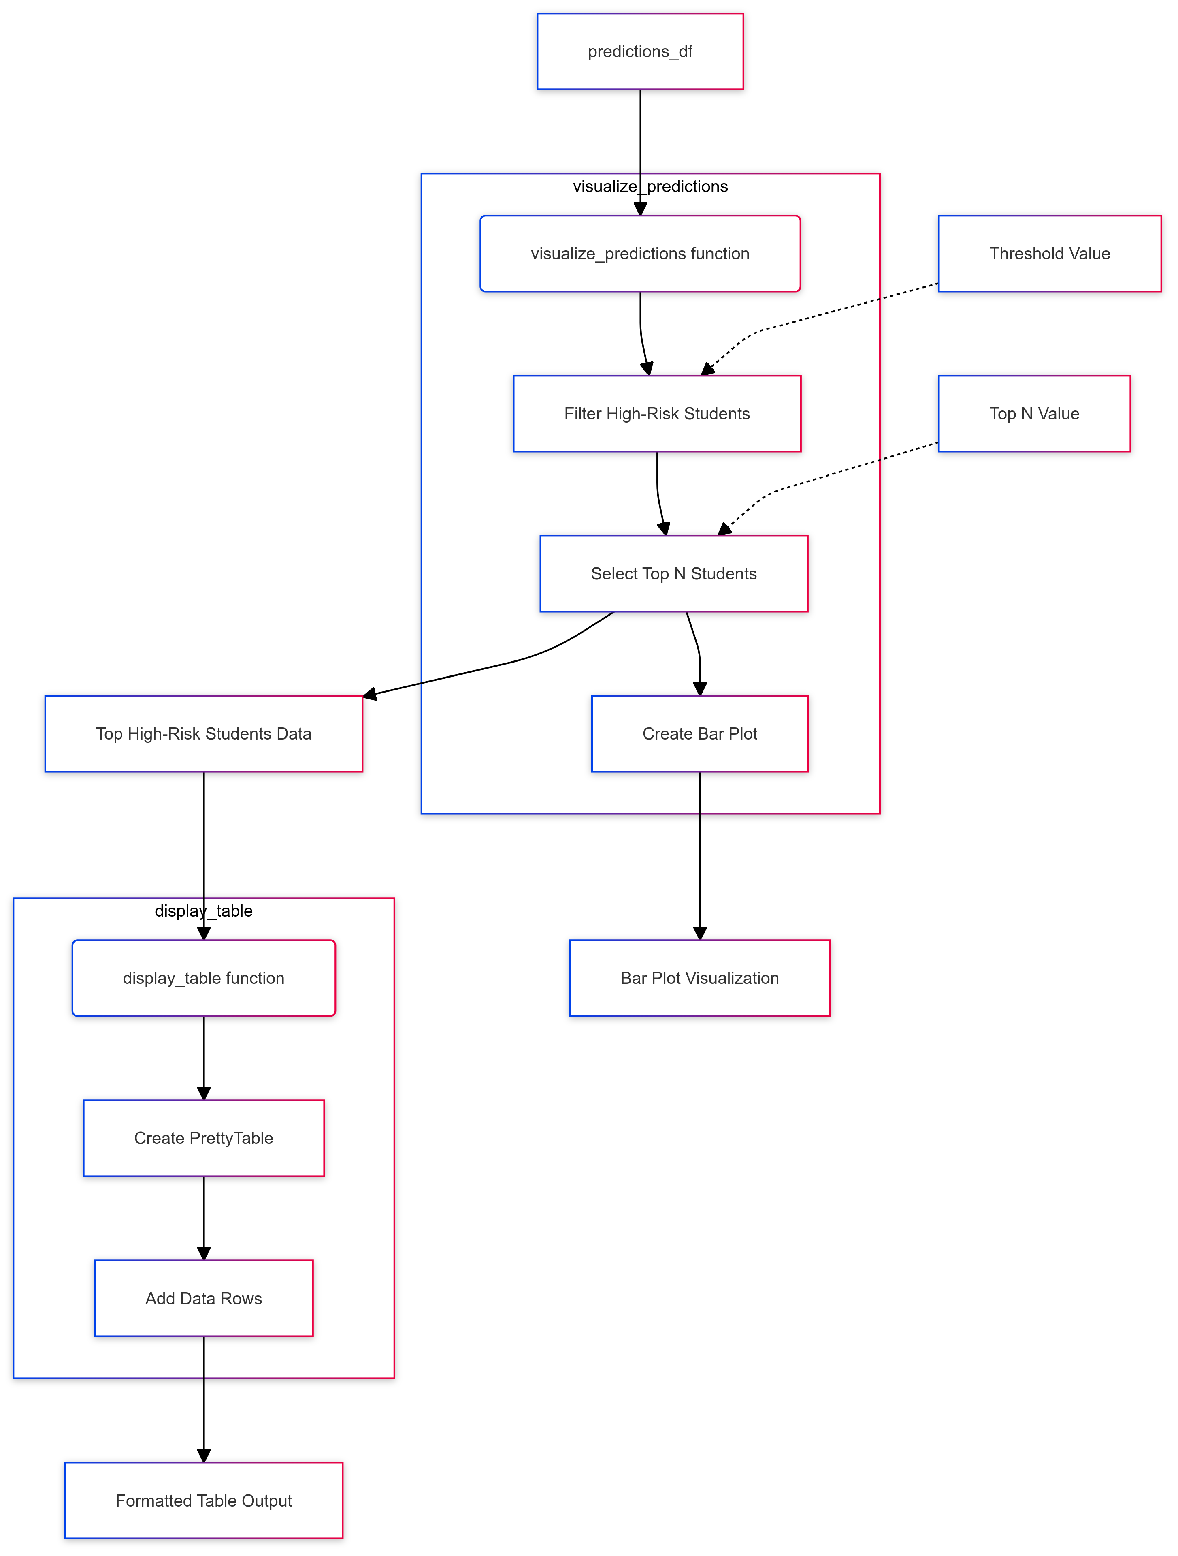
Reporting and Visualization Module DFD

Slide 33
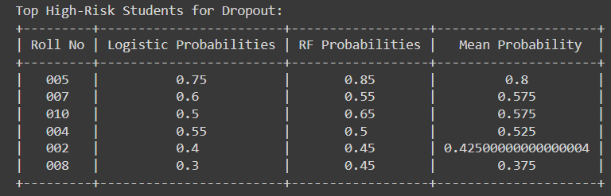
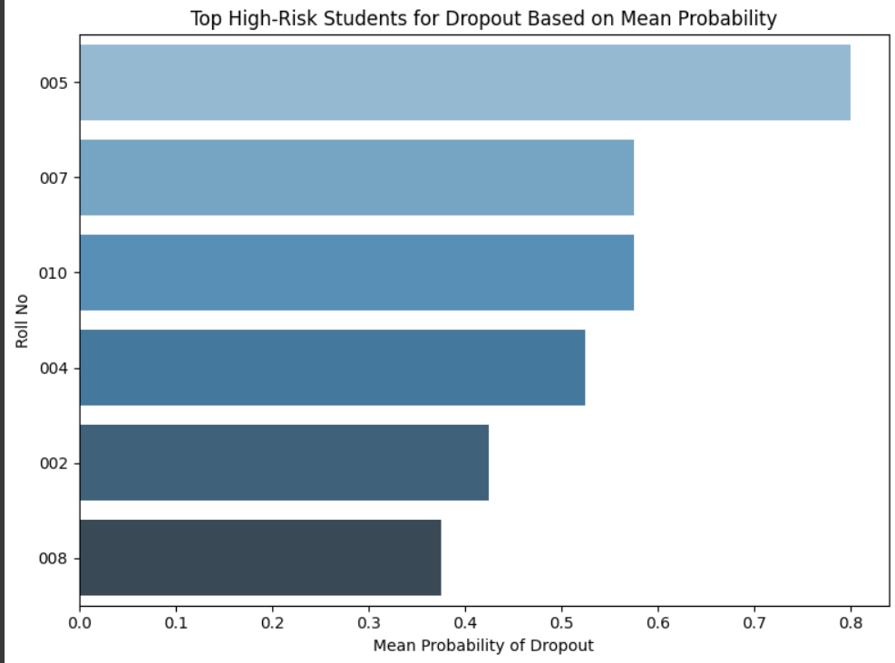
Reporting and Visualization Module Output

Slide 34
Algorithm for Visuvalization Module
Step 1: Filter students with high dropout probabilities based on a predefined threshold (e.g., 0.3).
Step 2: Create bar plots to visualize the top high-risk students and their probabilities.
Step 3: Generate a summary table to present key statistics and predictions for stakeholders.
Step 4: Calculate the mean probability from Logistic Regression and Random Forest outputs for consistency.
Step 5: Present insights in a user-friendly format for decision-making.

Slide 35
Conclusion
This project successfully utilized machine learning techniques, specifically Logistic Regression and Random Forest, to predict student dropouts by analyzing key factors such as GPA, attendance, and previous qualifications. The Random Forest model outperformed Logistic Regression in accuracy, enabling better identification of at-risk students. Visualizations of high-risk students effectively communicated our findings, demonstrating the potential of data-driven approaches to improve student support strategies, enhance retention rates, and ultimately foster better academic outcomes.

Slide 36
References.
J. K.Author,Advancement in Prediction, xth ed. City of Publisher, (only U.S. State), Country: Publisher, year.
S. H. Lee and J. K. Choi, "Predicting student performance using data mining techniques," *IEEE Access*, vol. 7, pp. 123456-123466, Jan. 2019.
M. Jones and L. Smith, "An approach to dropout prediction using machine learning," in *Proc. IEEE Int. Conf. on Data Mining*, Dallas, TX, USA, 2020, pp. 98-105.
U.S. Department of Education, *National Center for Education Statistics: The Condition of Education 2021*, Report no. NCES 2021-144, Washington, DC, USA, 2021.

Slide 37
Thank You

